Slide 1
18
.NET Core Development

Slide 2
Objectives
Explain what is .NET Core
List the differences between .NET Core and .NET Framework
Explain how to run a program on .NET Core

Slide 3
Introduction to .NET Core
.NET Core is an open source .NET Framework platform available for Windows, Linux, and Mac OS.
Following are the key features of .NET Core:
Cross-platform and Container Support
Support for Microservices
High Performance
Dependency Injection (DI)
Multiple Environments and Development Mode
Asynchronous via Async/Await
Unified MVC and Web API Frameworks

Slide 4
Where and When to Use .NET Core
Docker containers are being employed.
Server apps can be set up cross-platform to Docker containers.
For containers.
Where
There is a need for a high performance and scalable system.
Users are executing several .NET versions side-by-side.
To set up applications that have dependencies on diverse versions of frameworks.
Command Line Interface (CLI) control is required.
When

Slide 5
When Not to Use .NET Core
Following are some of the features that are currently not supported in .NET Core and hence, not recommended in situations that need these:
Certain.NET features and libraries and extensions
Windows Forms and WPF applications
Third-party library support
ASP.NET Web
Forms
Partial support for VB.NET and F#
Windows Communication Foundation (WCF)
SignalR

Slide 6
.NET Framework in Comparison with .NET Core(1-2)
As .NET Framework can also work with Docker and Windows Containers, utilizing it in the following situations is possible:
When it is already being employed.
When utilizing third-party libraries or NuGet packages that are not supported in .NET Core.
When utilizing technologies that are not yet offered by .NET Core.
When .NET Core is not supported by the platform.

Slide 7

.NET Framework in Comparison with .NET Core(2-2)
Following are the situations in which .NET Framework should not be used:
When several OS platforms are needed.
When high performance and scalability are required.
When .NET Core works.
When open source framework is needed.

Slide 8
Porting from .NET Framework to .NET Core
Evaluate Third Party Dependencies
Focus on the .NET Standard Library
Retarget Projects
Port Tests Code Execute the Porting Plan

Slide 9
Differences Between .NET Framework and .NET Core (1-3)
.NET Framework | .NET Core
It was made available as a licensed and proprietary software framework. | It was released as an open source software framework.
It allows users to create applications for a single platform - Windows. | It accommodates three different OSes - Windows, OS X, and Linux.
It must be set up as a single package and runtime environment for Windows. | It can be packaged and set up irrespective of the underlying OS.
It uses CLR for managing libraries and compilation purposes. | It utilizes a redesigned CLR known as CoreCLR and a modular collection of libraries known as CoreFX.
If utilizing Web applications, users can employ a robust Web application framework, such as ASP.NET. | It has a redesigned version of ASP.NET.

Slide 10
Differences between .NET Framework and .NET Core (2-3)
.NET Framework | .NET Core
Users must deploy Web applications only on Internet Information Server. | The Web applications can be run in several ways.
It has extensive APIs for creating cloud-based applications. | It has features that ease the creation and deployment of Cloud-based application.
It does not have any robust framework or tools to simplify mobile app development. | It is compatible with Xamarin via the .NET Standard Library.
It provides few options for developing microservice oriented systems | It allows the creation of microservice oriented systems rapidly.
It requires additional infrastructure to achieve scalability. | It enhances the performance and scalability without having to deploy extra hardware or infrastructure.
10

Slide 11
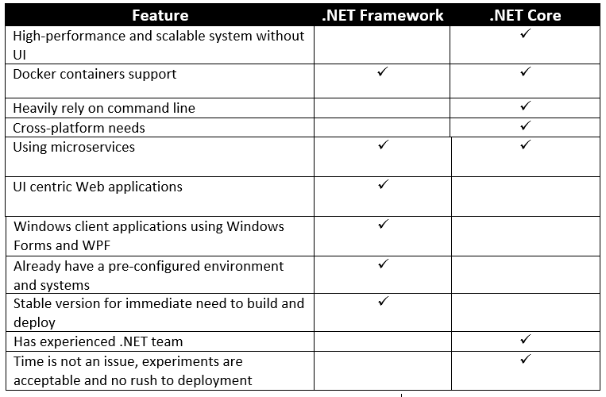
Differences between .NET Framework and .NET Core (3-3)
Following table summarizes which of the two (.NET Framework or
.NET Core) is preferred:

Slide 12
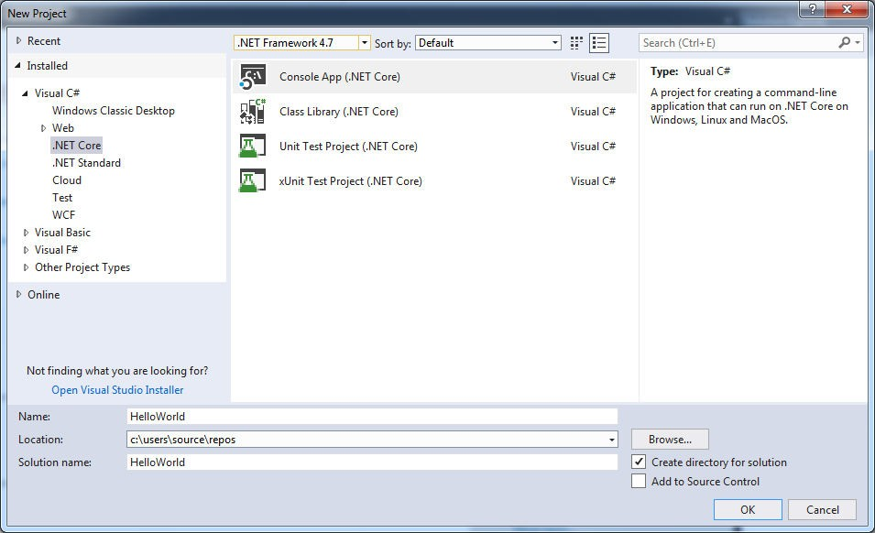

Running a Program on .NET Core (1-2)
Following are the steps to create a simple ‘Hello World’ console application:
Start Visual Studio 2017. Click File→New→Project. The New Project dialog appears as shown in the figure.
Choose Visual C# followed by the .NET Core node.
b. Next, choose the Console App (.NET Core) project template.
New Project Dialog Box
c. Provide the name 'HelloWorld' in the Name field and click OK.

Slide 13
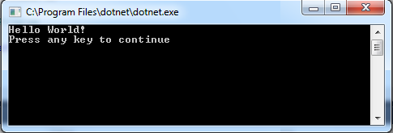
Running a Program on .NET Core(2-2)
On the menu bar, click Build → Build Solution.
Execute the program. Following figure shows the output of the program.
Output of the Program

Slide 14
Summary
.NET Core is an open source .NET Framework platform available for Windows, Linux, and Mac OS.
The key features of .NET Core are Cross-platform and container support, High performance, Asynchronous via async/await, Unified MVC and Web API Frameworks, Multiple environments and development mode, Dependency injection and Support for Microservices.
.NET Core is a perfect fit if there is a need for a high performance and scalable system.
Microsoft suggests executing .NET Core along with ASP.NET Core to obtain best performance and scale.
.NET Core is usable if users are executing several .NET versions side-by- side.
Though there are a lot of instances when .NET Core can be utilized, there are situations in which it is not recommended for use.

